Slide 1
Vinay G V (1ST21CS237)
Team Leader
Team Member USN No and Name
Shashishekhara K (1ST21CS192)
Shivashankar MG (1ST21CS196)
Praveen BM (1ST22CS413)
Guide Name
Prof. Deepa. S Bhat
Title of the Project
AI-Driven crop Disease Prediction and Management System

Slide 2
Why is the Particular Topic Chosen
Enhancing Agricultural Productivity: Crop diseases significantly impact yields. Early detection and management help improve overall agricultural productivity.
Empowering Farmers: Provides farmers with accessible, AI-driven tools to identify and manage crop diseases without replying solely on experts.
Cost and Time Efficiency: Automates disease detection, saving time and reducing costs associated with manual inspections and expert consultations.
Preventing Losses: Helps prevent large-scale crop failures by enabling timely intervention.
Sustainability: Promotes healthier crops and reduces excessive use of pesticides, contributing to sustainable farming practices.
Technology Integration in Agriculture: Demonstrates the practical use of AI to modernize traditional farming methods.
Addressing Global Challenges: Tackles a pressing global issue, as crop diseases are a major concern for food security and the agricultural economy.
AI-Driven crop Disease Prediction and Management System
Title of the Project

Slide 3
Objective of the Project
1
Accurate Disease Diagnosis :
Detect and identify crop diseases using image-based analysis of diseased leaves.
Provide precise and reliable results to enable early intervention.
2
Effective Management Recommendations:
Suggest appropriate treatments and management strategies to mitigate disease impact.
Recommend preventive measures to minimize future occurrences.
Improved Agricultural Practices:
Support farmers in making data-driven decisions to increase crop yield and quality.
Reduce the dependency on guesswork and enhance efficiency in managing resources.
3
4
Sustainable Farming:
Minimize the use of unnecessary chemicals through targeted treatments.
Promote environmentally friendly and sustainable farming practices.
AI-Driven crop Disease Prediction and Management System
Title of the Project

Slide 4
Statement about the Problem
Agriculture is a cornerstone of global food security and economic stability, yet it faces numerous challenges, including the pervasive impact of plant diseases. Crop diseases can drastically reduce yield and quality, threatening the livelihoods of farmers and the global food supply chain. The traditional methods of disease detection often rely on manual inspection, which is time-consuming, prone to errors, and requires expert knowledge that may not always be accessible to farmers in rural or underdeveloped areas.
Moreover, delayed or incorrect disease identification can lead to inappropriate treatment, further exacerbating the problem through excessive use of pesticides, increased costs, and environmental degradation. There is a critical need for a reliable, efficient, and scalable solution that empowers farmers with timely and accurate disease detection, enabling effective management practices and minimizing losses.
AI-Driven crop Disease Prediction and Management System
Title of the Project

Slide 5
Literature Survey
Authors | Paper Title and Publication Year | Methodology used | Merits | Demerits
Authors | Paper Title and Publication Year | Methodology used | Merits | Demerits
Mohanty, Sharada P. | Using Deep Learning for Image-Based Plant Disease Detection (2019) | Convolutional Neural Networks (CNN) | High accuracy in detecting plant diseases using image data. | Requires large datasets; not effective in detecting unseen diseases.
Sladojevic S. | Deep Neural Networks for Plant Disease Recognition (2020) | CNN and Transfer Learning | Real-time prediction with high precision; suitable for mobile devices. | Limited to diseases included in the training dataset; hardware dependency.
AI-Driven crop Disease Prediction and Management System
Title of the Project

Slide 6
Literature Survey
Authors | Paper Title and Publication Year | Methodology used | Merits | Demerits
Authors | Paper Title and Publication Year | Methodology used | Merits | Demerits
Kamilaris A. and Prenafeta-Boldu F. X. | Deep Learning in Agriculture: A Survey (2021) | Survey and analysis of AI techniques | Comprehensive review; discusses various deep learning methods in agriculture. | Does not include implementation details; lacks a focus on specific disease prediction techniques.
Too, E. C. | A Comparative Study of Fine-Tuning Deep Learning Models for Plant Disease Identification (2023) | Transfer Learning with pre-trained models | Reduces training time and computational costs; effective for small datasets. | Limited to the features of pre-trained models; may overfit on smaller datasets.
AI-Driven crop Disease Prediction and Management System
Title of the Project

Slide 7
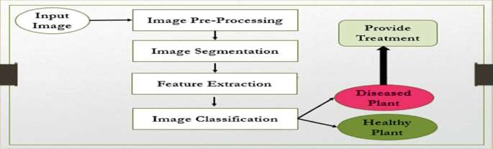
Architecture Diagram
AI-Driven crop Disease Prediction and Management System
Title of the Project

Slide 8
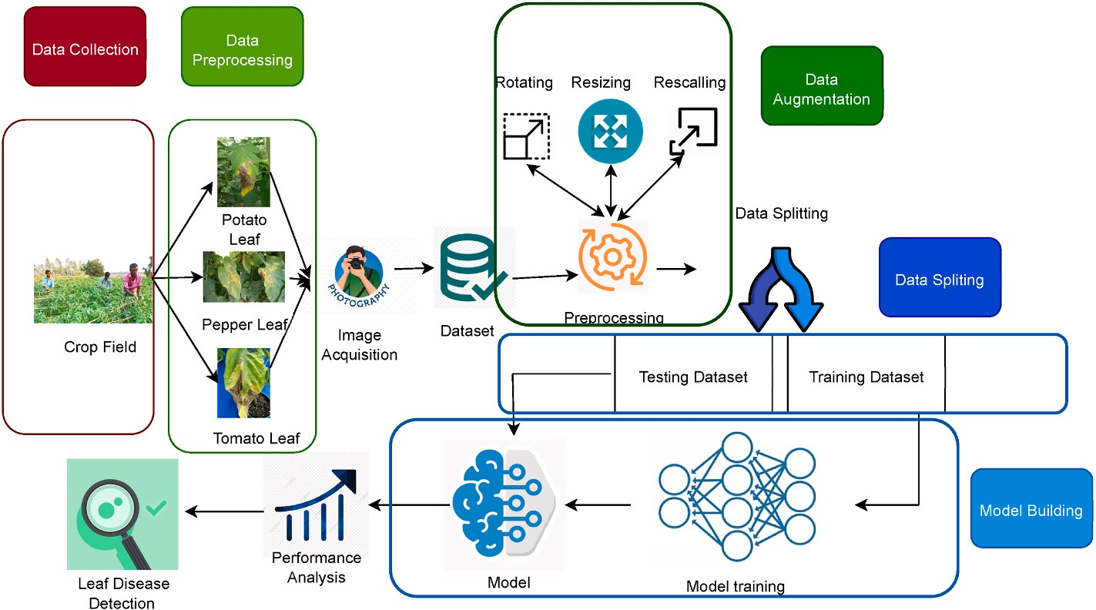
Use case Diagram
Title of the Project

Slide 9
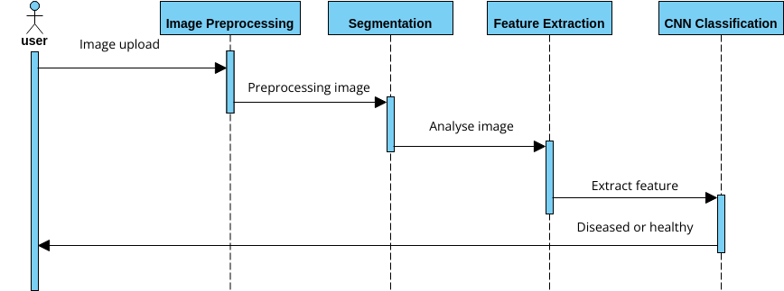
Sequence Diagram
AI-Driven crop Disease Prediction and Management System
Title of the Project

Slide 10
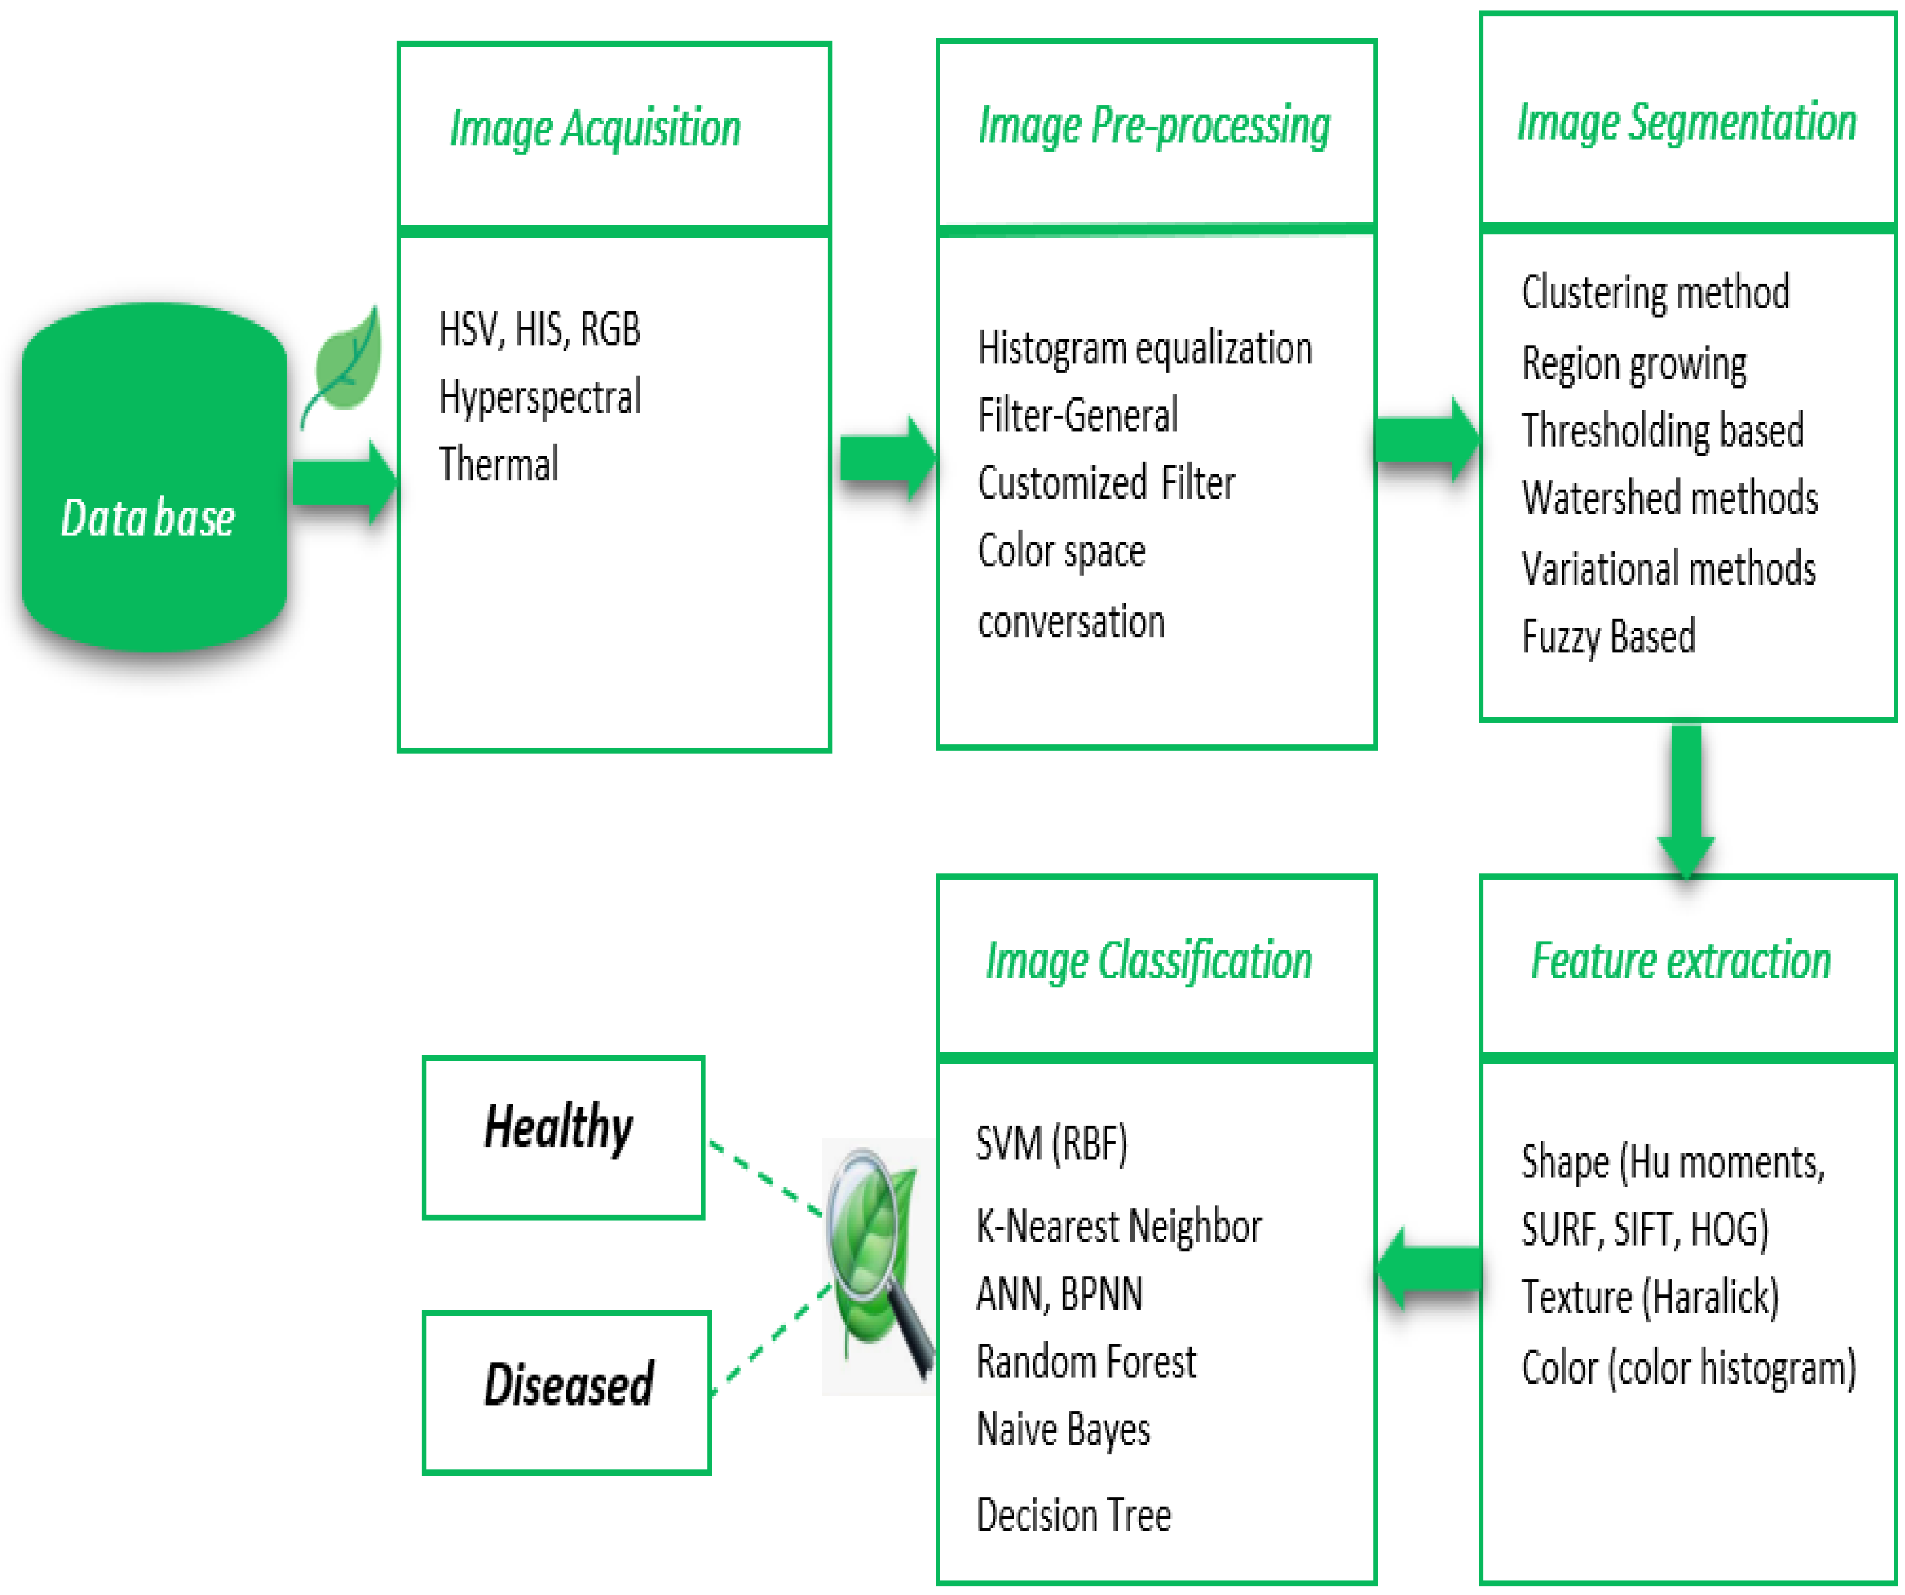
Class Diagram
AI-Driven crop Disease Prediction and Management System
Title of the Project

Slide 11
Scope of the project
The AI-Driven Crop Disease Prediction and Management System aims to develop a web web-based application that utilizes machine learning algorithms to analyze crop images and environmental data for early disease detection.
This project seeks to revolutionize agricultural practices by leveraging AI to support farmers in making informed decisions, ultimately leading to improved crop yields and sustainability.
It provides real-time recommendations for preventive measures and treatments, empowering farmers to take timely actions to mitigate crop losses.
AI-Driven crop Disease Prediction and Management System
Title of the Project

Slide 12
Hardware and Software to be used
Hardware Requirements
Input Devices: Cameras/Smartphones for leaf images; sensors for environmental data.
Processing Units: High-performance servers, GPUs (e.g., NVIDIA RTX), edge devices (NVIDIA Jetson, Google Coral).
Storage: Cloud and local SSD/HDD storage.
Other Hardware: Drones for aerial imaging; IoT devices for environmental monitoring.
Software Requirements
AI/ML Frameworks: TensorFlow, PyTorch, OpenCV, Scikit-learn.
Database: MySQL/PostgreSQL (SQL).
Cloud Platforms: AWS, Google Cloud, or Azure.
Web/Mobile Development: HTML/CSS/JS, React/Angular, Python (Flask/Django), Flutter.
APIs: TensorFlow.js, FastAPI, GIS tools (QGIS).
Collaboration: Git/GitHub/GitLab.
Other Tools: Jupyter Notebooks, LabelImg, Matplotlib, Tableau.
AI-Driven crop Disease Prediction and Management System
Title of the Project

Slide 13
What Contribution would the project make?
1. Early Disease Detection
Helps farmers identify diseases at an early stage by analyzing leaf images using AI-powered models, reducing the risk of severe crop loss.
Provides insights into diseases that may not be easily identified through visual inspection by untrained individuals.
2. Increased Agricultural Productivity
By identifying and treating diseases early, crops are protected, ensuring better yield and quality.
Encourages timely intervention to minimize the impact of diseases.
3. Cost-Effective Solutions
Reduces the cost associated with traditional lab-based testing and expert consultations.
Suggests targeted treatments, saving money on unnecessary or ineffective interventions.
4. Data-Driven Decision Making
Provides actionable insights based on real-time analysis of soil, crop type, and disease data.
Helps in creating a database of common diseases and their successful treatments for future reference.
5. Improved Sustainability
Reduces the misuse of pesticides and fertilizers by recommending precise treatments.
Encourages environmentally friendly practices by limiting chemical overuse.
6. Supports Food Security
Protects crops from widespread diseases, ensuring a stable supply of food.
Reduces the likelihood of economic losses in agricultural communities, contributing to overall food system stability.
AI-Driven crop Disease Prediction and Management System
Title of the Project

Slide 14
Result Analysis
The system takes an image of a plant leaf as input and then proceeds through several stages to determine if the plant is healthy or diseased, and to provide treatment recommendations if needed. The process begins with image pre-processing, where the input image is enhanced or cleaned (e.g., adjusting brightness, contrast, removing noise). Next, image segmentation isolates the leaf or specific regions of interest (often the infected areas) from the background.
Once the regions of interest are clear, feature extraction gathers important information (such as color, texture, or shape patterns) that best represent the health condition of the leaf. These features are then fed into an image classification algorithm, which analyzes them to categorize the plant as either “Diseased Plant” or “Healthy Plant.” If the result is a diseased plant, the system can provide specific treatment recommendations. This end-to-end process ensures that the system can identify the presence of a disease and suggest corrective actions in a systematic manner.
AI-Driven crop Disease Prediction and Management System
Title of the Project

Slide 15
Conclusion and Future Enhancement
The Farmer’s Assistant is a user-friendly web application that leverages machine learning and web scraping to empower farmers with real-time, data-driven insights. It features crop recommendation via the Random Forest algorithm, fertilizer advice through a rule-based classification system, and crop disease detection using the EfficientNet model to analyze leaf images—all accessible through intuitive user interfaces that handle diverse inputs like soil nutrient levels and crop types. Built with a responsive design and an optimized backend for reliability and scalability, the system not only provides prompt, actionable guidance but also paves the way for future enhancements such as automatic soil testing integration, seasonal growth predictions, personalized advice, live weather data, geographical analysis, historical yield tracking, and a collaborative community forum, all while aiming to support multiple languages and local farming practices.
Our application runs smoothly, and we plan several enhancements to boost functionality. We aim to integrate features that show the availability of recommended items on shopping websites and refine fertilizer suggestions using data on various brands and N, P, and K values. Future updates include advanced machine learning to incorporate weather, geographic, and seasonal trends, along with real-time soil testing integration. Additionally, we plan to develop an intuitive dashboard with insights like nutrient trends and yield predictions, integrate drone-based crop monitoring, and offer pest control and organic farming advice, all with multilingual and personalized support for diverse farming communities.
AI-Driven crop Disease Prediction and Management System
Title of the Project

Slide 16
References
Mohanty, Sharada P. "Using Deep Learning for Image-Based Plant Disease Detection." Frontiers in Plant Science, 2021.
This paper discusses the use of convolutional neural networks (CNNs) to detect plant diseases using leaf images with high accuracy.
Sladojevic S. "Deep Neural Networks Based Recognition of Plant Diseases by Leaf Image Classification." Computational Intelligence and Neuroscience, 2022.
Focuses on using CNNs for classifying plant diseases from leaf images.
Brahimi M. "Deep Learning for Plant Diseases: Detection and Saliency Map Visualization." IEEE Access, 2023.
Proposes a method for plant disease detection using CNNs and saliency map visualization to highlight affected areas.
AI-Driven crop Disease Prediction and Management System
Title of the Project

